Slide 1

Retail Online Commerce Solution
Group 15
Ram Gopal Varma Alluri (NEU ID - 002196886),
Mohit Sanghai (NEU ID - 001003865),
Rohith Bhat (NEU ID - 002119031),
Ashish Sharma (NEU ID - 002950309),
Santhosh Maddi (NEU ID - 002127881)

Slide 2


Retail Online Commerce Solution
Facilitates online business platforms to:
Manage order information
Customer information
Payment information
Shipping information

Slide 3
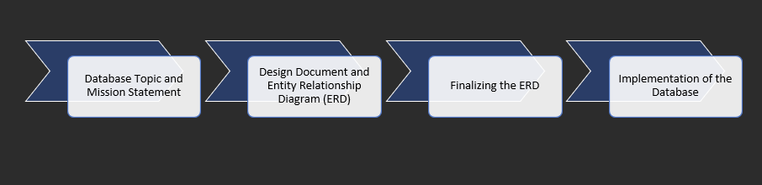
PHASE Diagram

Slide 4

ENTITY RELATIONSHIP DIAGRAM

Slide 5
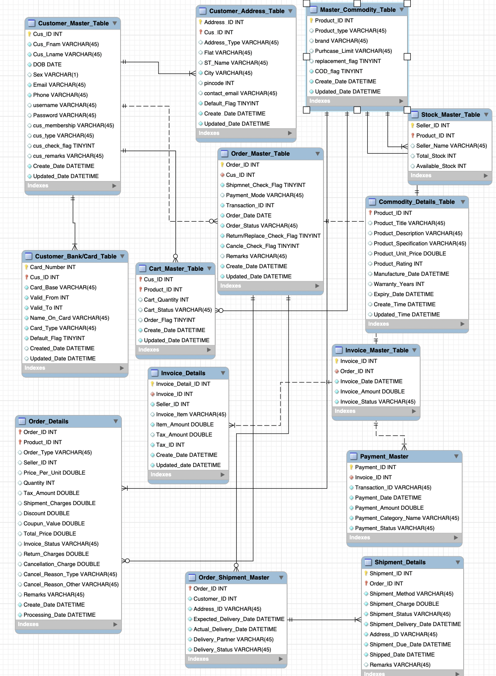

Slide 6

Data implementation

Slide 7
Create Table
Customer.Customer_Base | Orders.Cart_Master
Customer.Customer_Address | orders.Order_Details
Customer.Customer_Card_Detail | Orders.Order_Master
Commodity.Commodity_Details | Shipment.Order_Shipment_Master
Commodity.Stock_Master | Shipment.Shipment_Details
Invoice.Invoice_Details | Invoice.Payment_Master;
Invoice.Invoice_Master

Slide 8
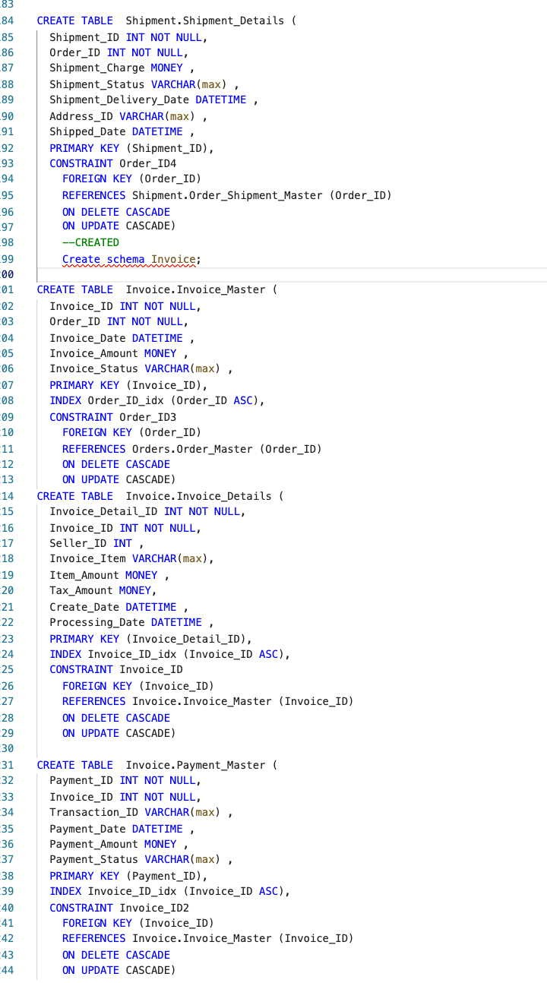
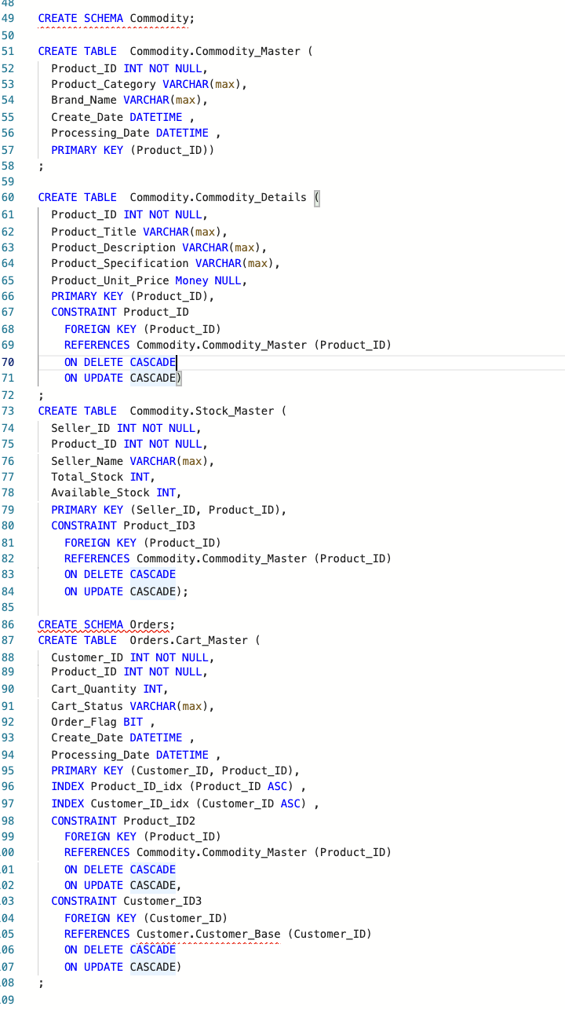
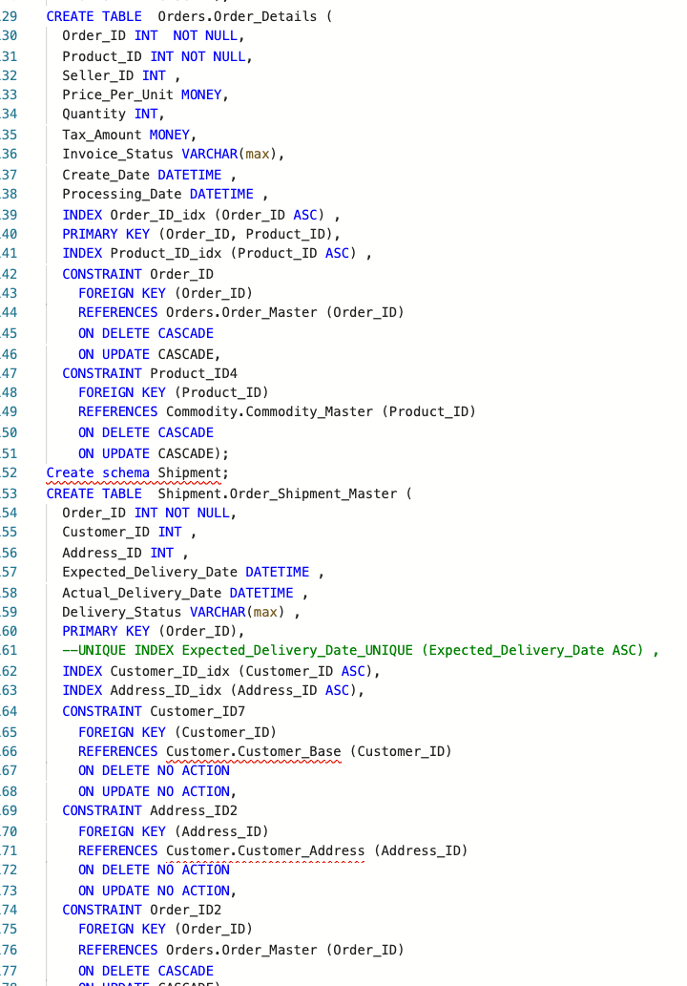
CREATE TABLES

Slide 9
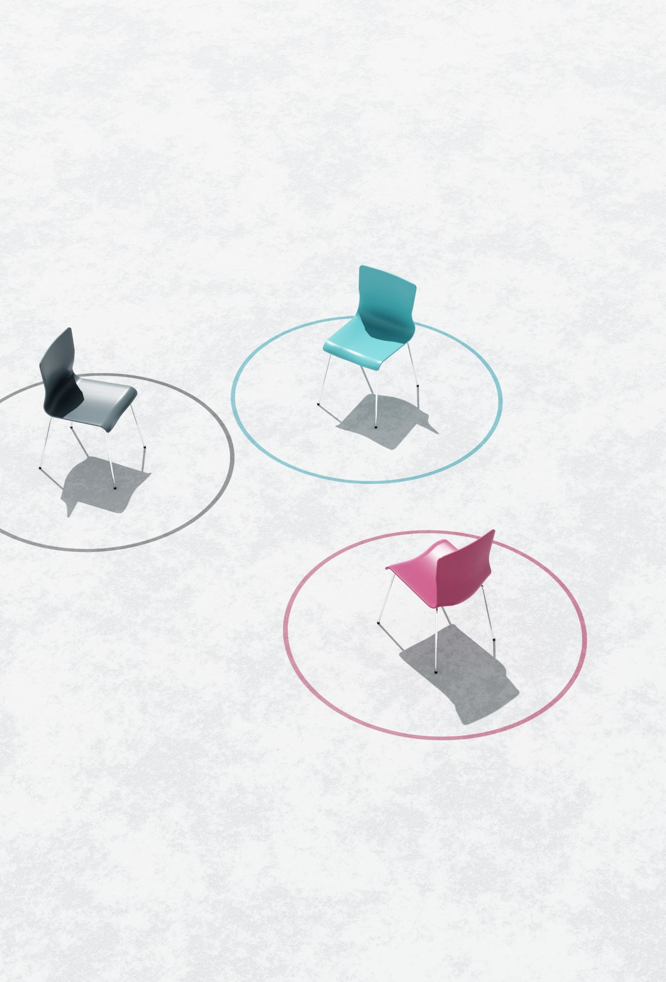
Computational column
ALTER TABLE Orders.Order_Details
add Total_Price AS (dbo.fn_Calc_Total_Price(Order_ID,Product_ID));

Slide 10
Functions/check constraint
CREATE FUNCTION fn_Calc_Total_Price(@OrdID INT,@PrdID INT)
RETURNS MONEY
AS
BEGIN
DECLARE @total MONEY =
(SELECT SUM((Price_Per_Unit * Quantity)+Tax_Amount)
FROM Orders.Order_Details
WHERE Order_ID =@OrdID and Product_ID =@PrdID );
SET @total = ISNULL(@total, 0);
RETURN @total;
END

Slide 11
trigger
CREATE TRIGGER Invoice_Status_Update
ON Invoice.Invoice_Master
after UPDATE
AS
BEGIN
UPDATE Orders.Order_Details
set Invoice_Status = (select Invoice_Status from Invoice.Invoice_Master im where Order_ID = od.Order_ID)
FROM Orders.Order_Details od
FULL JOIN Inserted i ON od.Order_ID = i.Order_ID
FULL JOIN Deleted d ON od.Order_ID = d.Order_ID
where (od.Order_ID = d.Order_ID or od.Order_ID = i.Order_ID)
END;

Slide 12
Trigger2
CREATE TRIGGER Customer.Update_Date
ON Customer.Customer_Base
after INSERT, UPDATE
AS
BEGIN
UPDATE Customer.Customer_Base
set Processing_Date = CURRENT_TIMESTAMP
FROM Customer.Customer_Base cb
FULL JOIN Inserted i ON cb.Customer_ID = i.Customer_ID
FULL JOIN Deleted d ON cb.Customer_ID = d.Customer_ID
where ((cb.Customer_ID = i.Customer_ID or cb.Customer_ID = d.Customer_ID)
and (i.Customer_ID IN (select Customer_ID from Deleted d)))
UPDATE Customer.Customer_Base
set Processing_Date = CURRENT_TIMESTAMP,Create_Date = CURRENT_TIMESTAMP
FROM Customer.Customer_Base cb
FULL JOIN Inserted i ON cb.Customer_ID = i.Customer_ID
FULL JOIN Deleted d ON cb.Customer_ID = d.Customer_ID
where ((cb.Customer_ID = i.Customer_ID or cb.Customer_ID = d.Customer_ID)
and i.Customer_ID NOT IN (select Customer_ID from Deleted d))
END;

Slide 13
Trigger 3
CREATE TRIGGER Address_Card_Delete
ON Customer.Customer_Base
AFTER DELETE
AS
BEGIN
DELETE CD
FROM Customer.Customer_Card_Detail CD
FULL JOIN Inserted i ON CD.Customer_ID = i.Customer_ID
FULL JOIN Deleted d ON CD.Customer_ID = d.Customer_ID
WHERE CD.Customer_ID IN (Select d.Customer_ID FROM Deleted d) AND
CD.Customer_ID NOT IN (Select i.Customer_ID FROM Inserted i) AND
(CD.Customer_ID = i.Customer_ID or CD.Customer_ID = d.Customer_ID)
DELETE AD
FROM Customer.Customer_Address AD
FULL JOIN Inserted i ON AD.Customer_ID = i.Customer_ID
FULL JOIN Deleted d ON AD.Customer_ID = d.Customer_ID
WHERE AD.Customer_ID IN (Select d.Customer_ID FROM Deleted d) AND
AD.Customer_ID NOT IN (Select i.Customer_ID FROM Inserted i) AND
(AD.Customer_ID = i.Customer_ID or AD.Customer_ID = d.Customer_ID)
END;

Slide 14
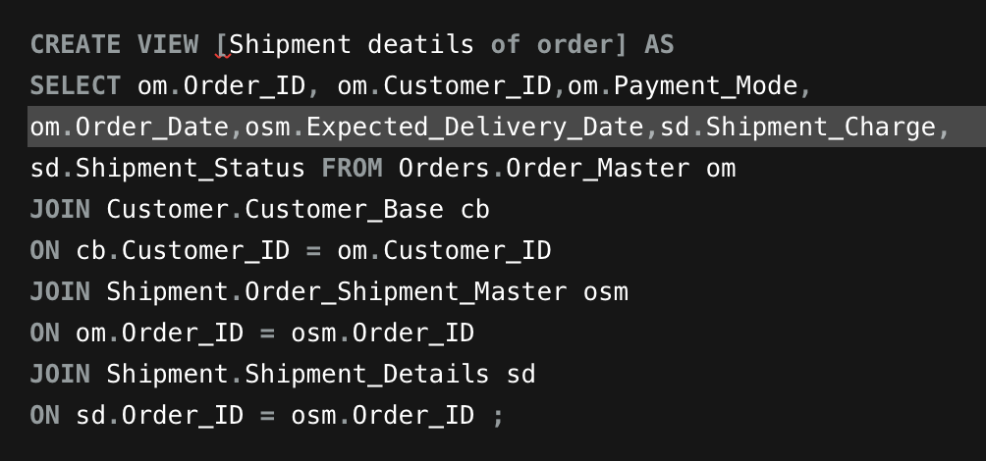
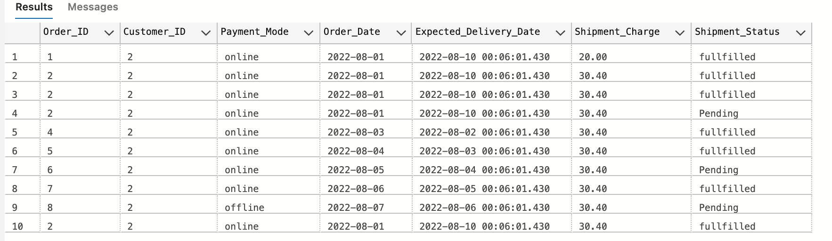
Data implementation view 1
.
select * from [Shipment deatils of order];

Slide 15
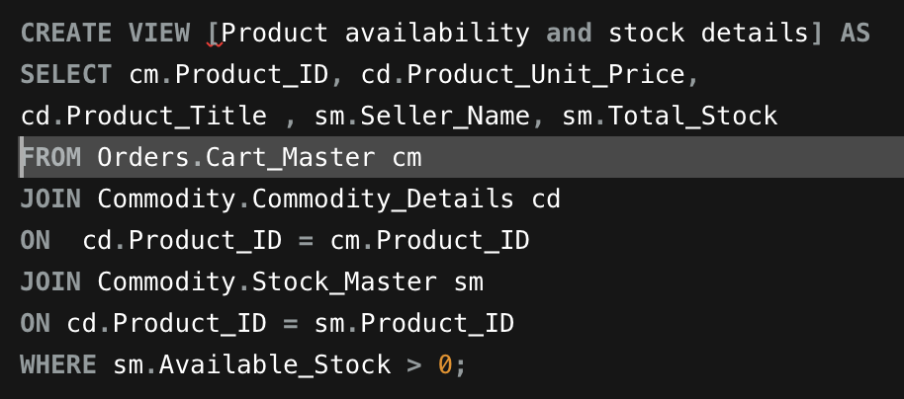
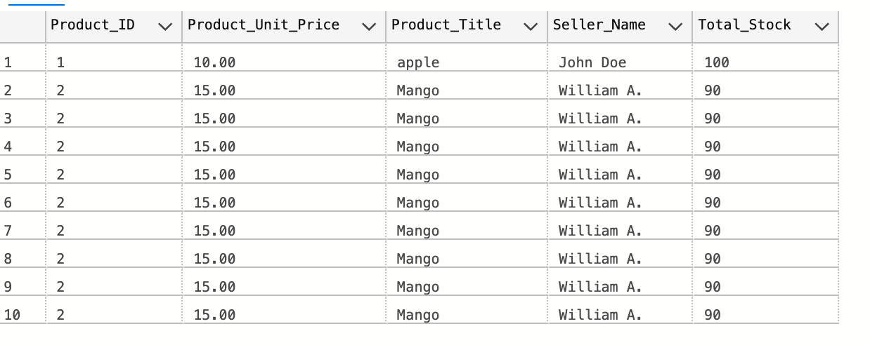
Data implementation view 2
select * from [Product availability and stock details];

Slide 16
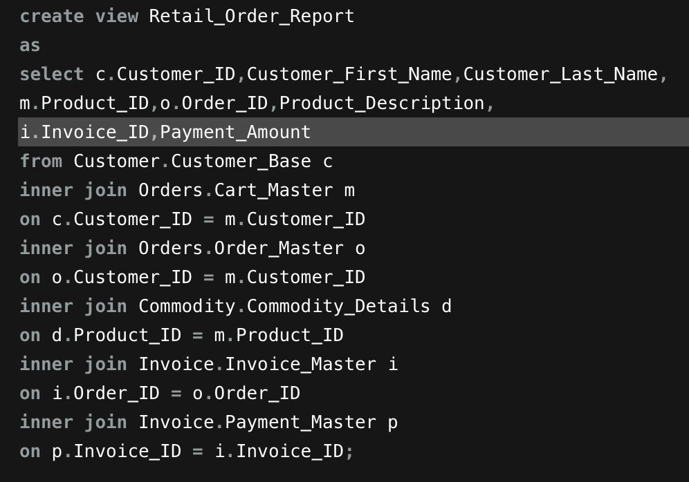
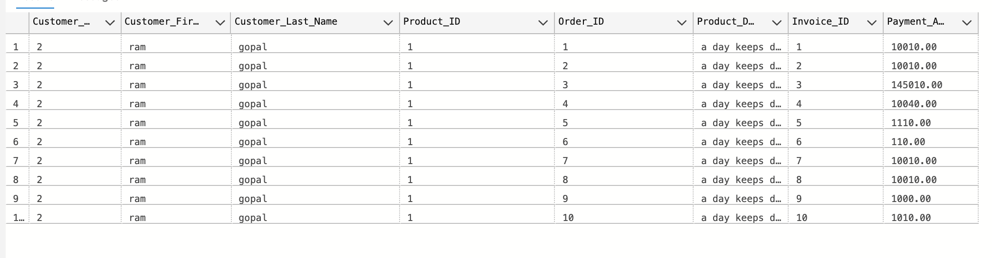
Data implementation – view 3
select * from Retail_Order_Report;

Slide 17

Data visualization

Slide 18
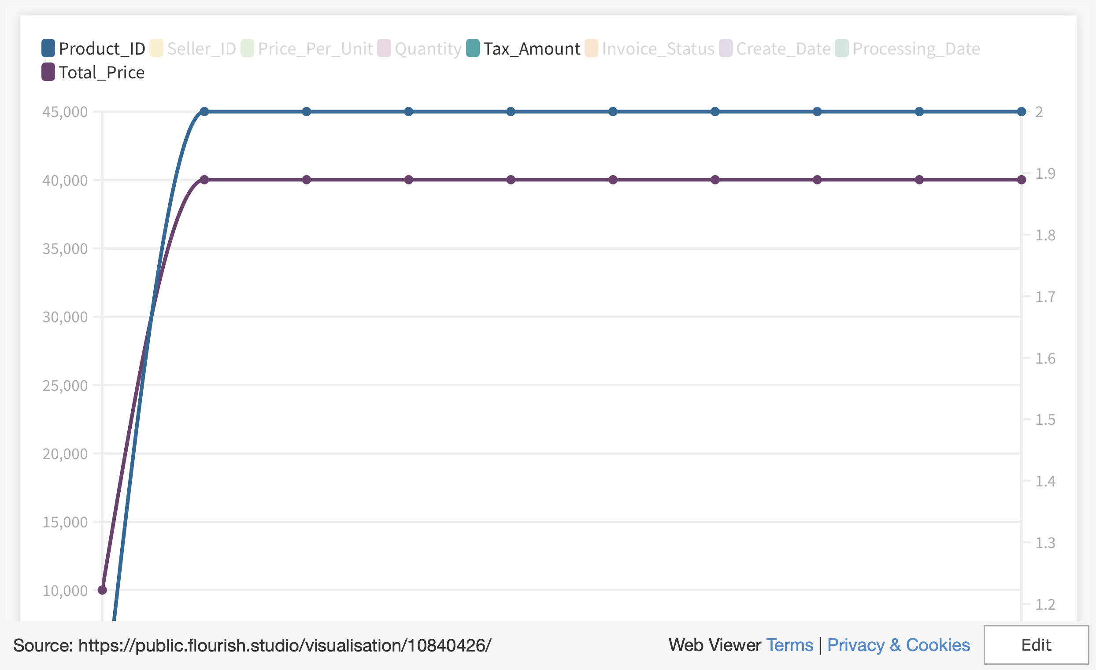
Notes:
https://public.flourish.studio/visualisation/10840426/

Slide 19
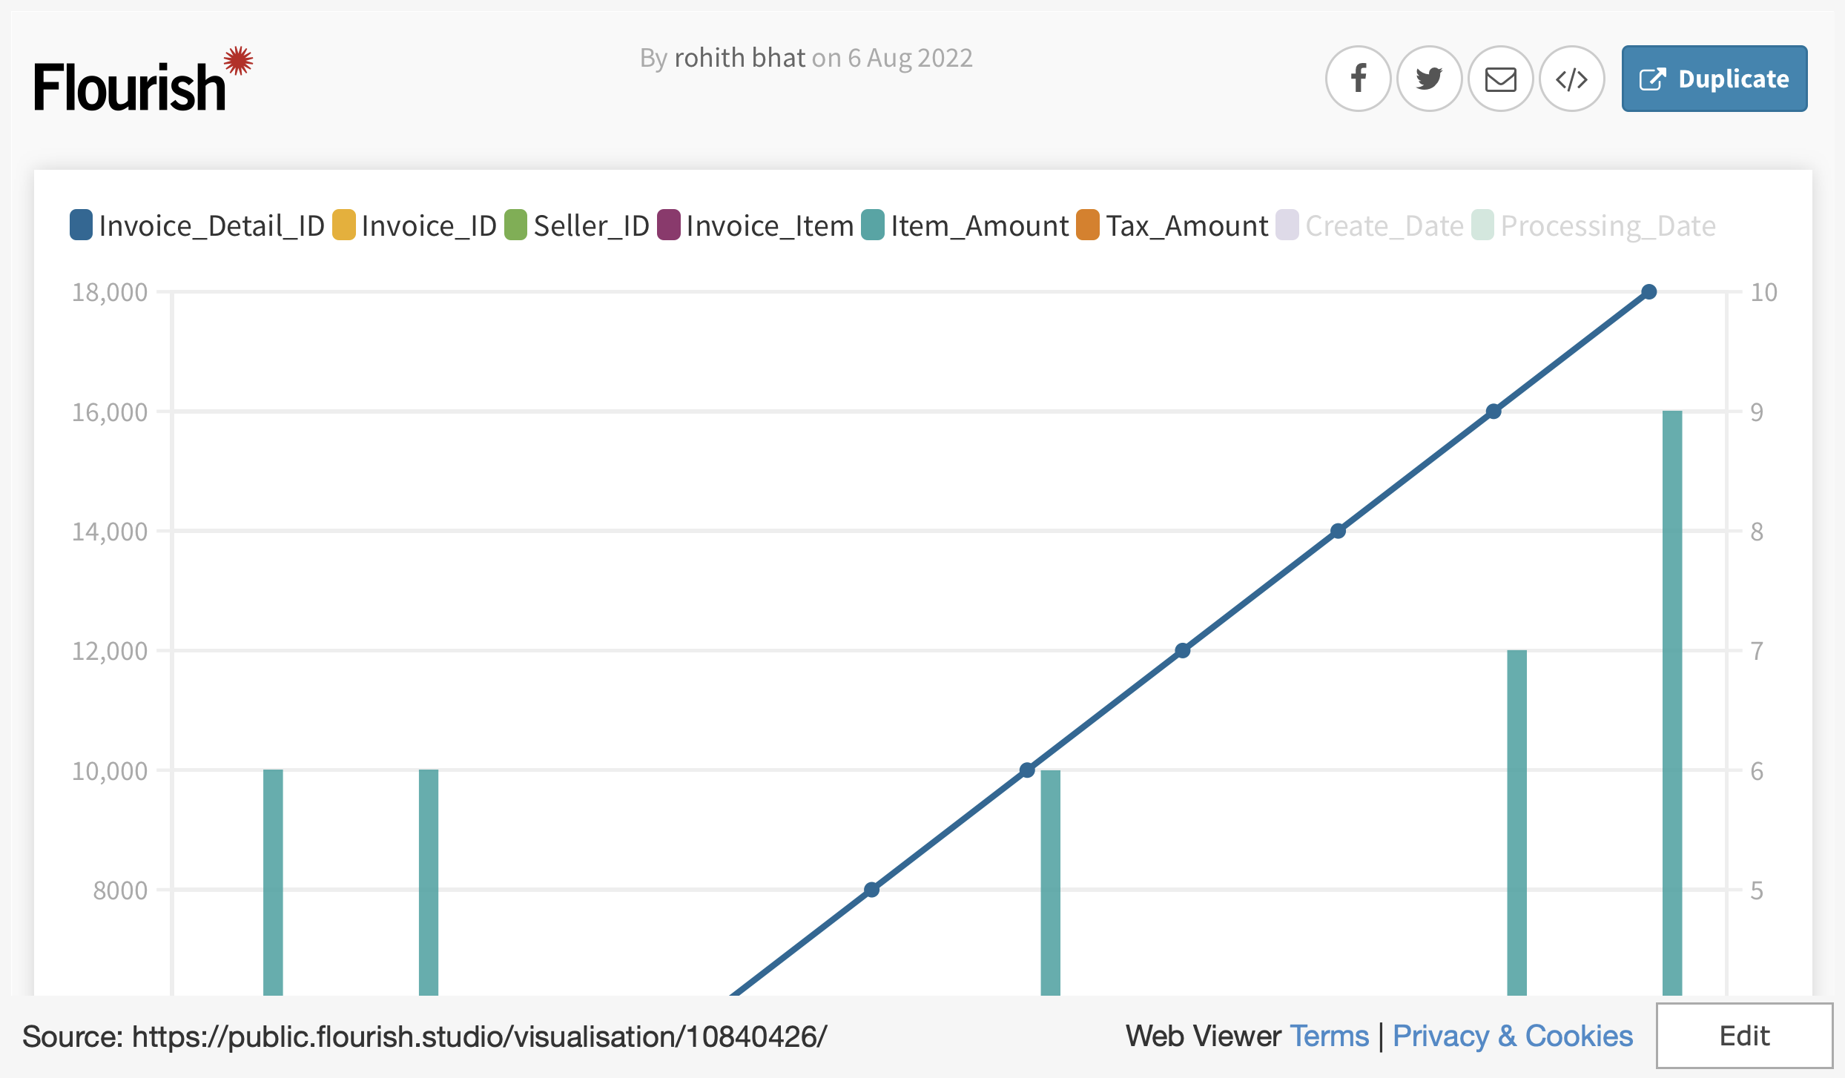
Notes:
https://public.flourish.studio/visualisation/10840426/

Slide 20
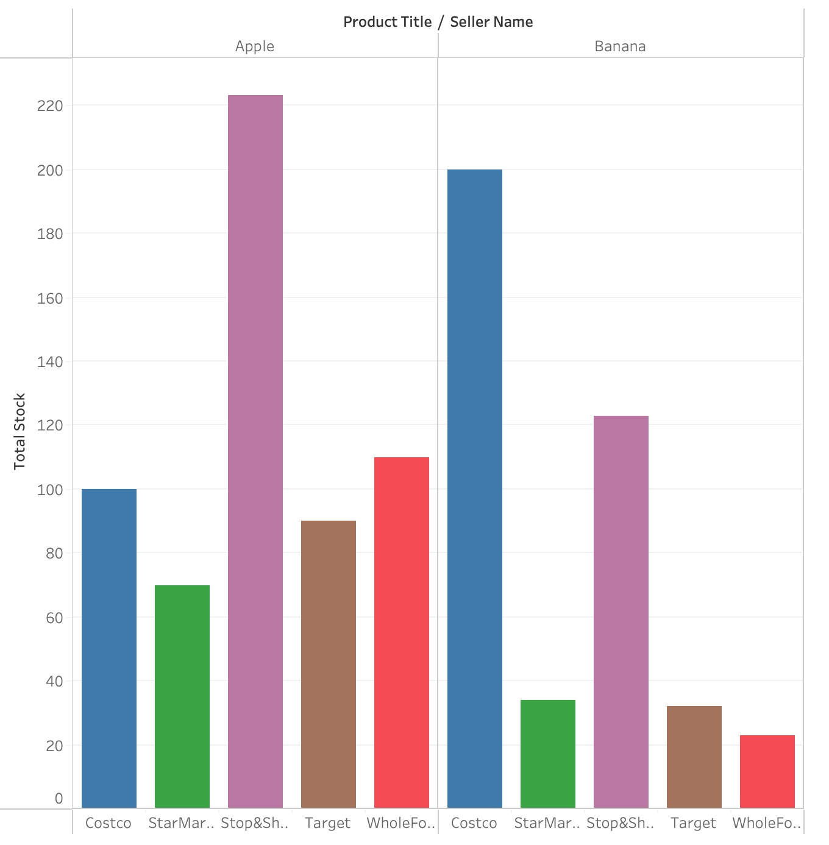
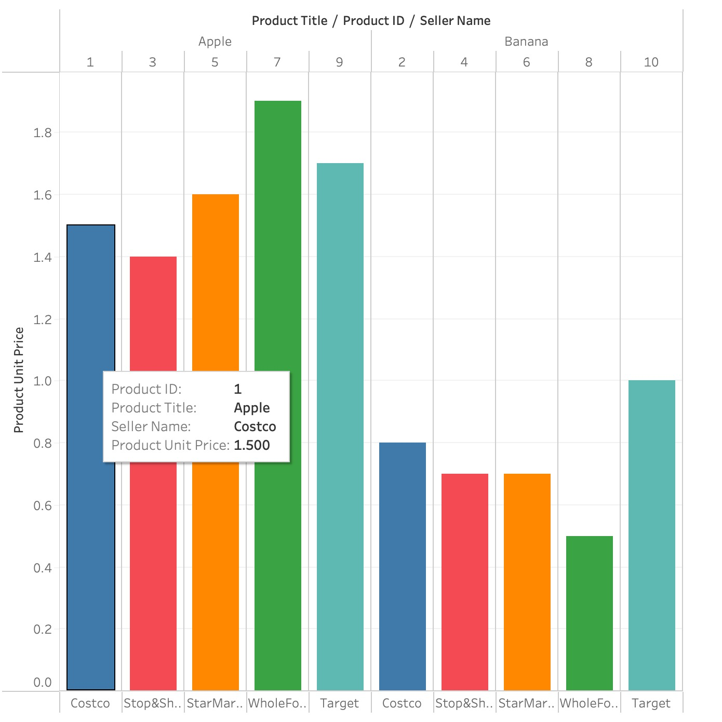

Slide 21
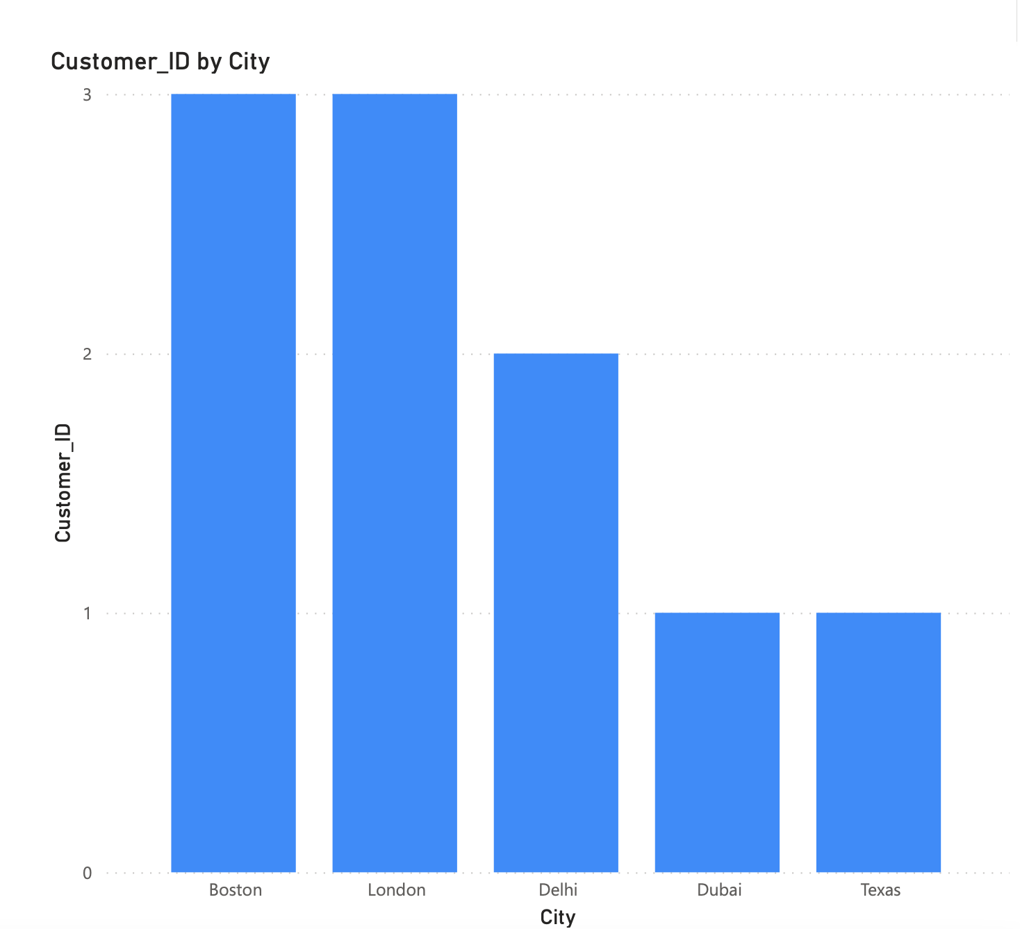
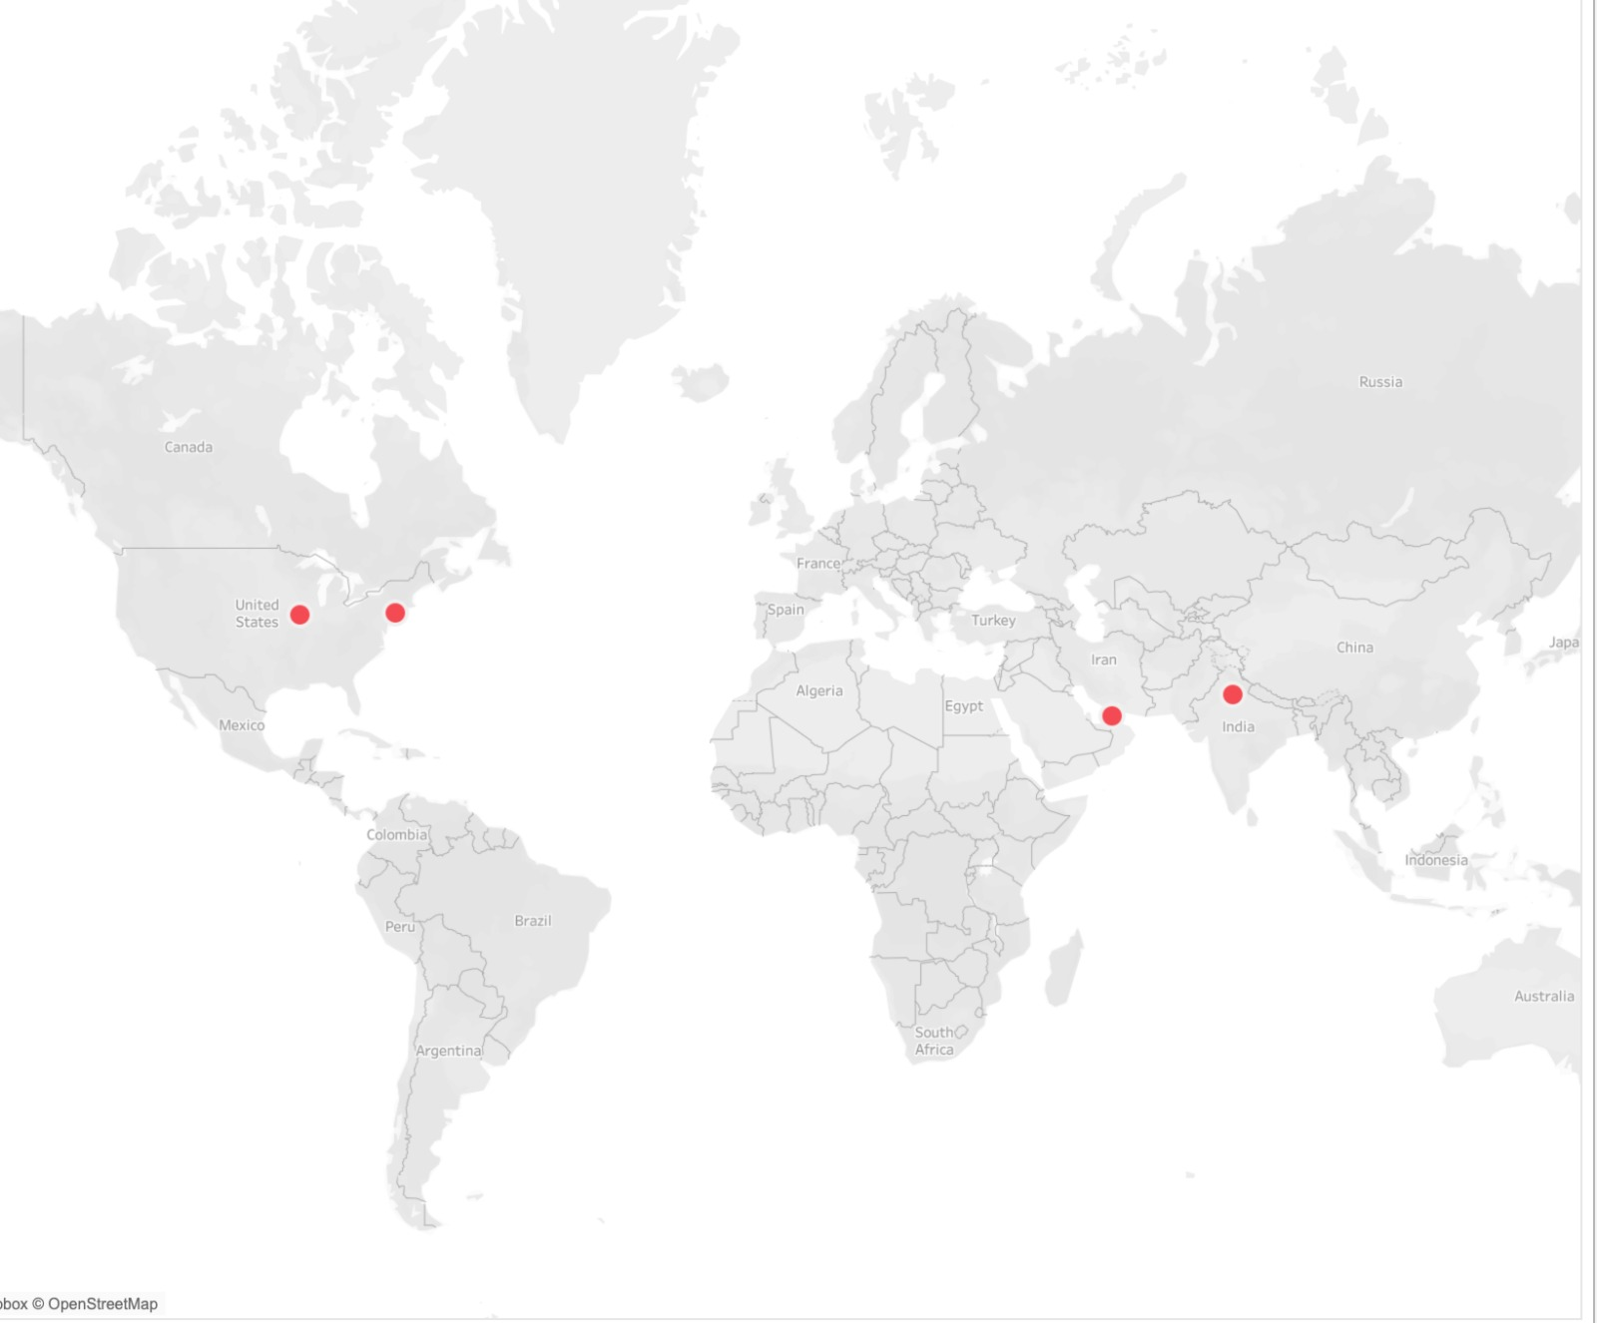
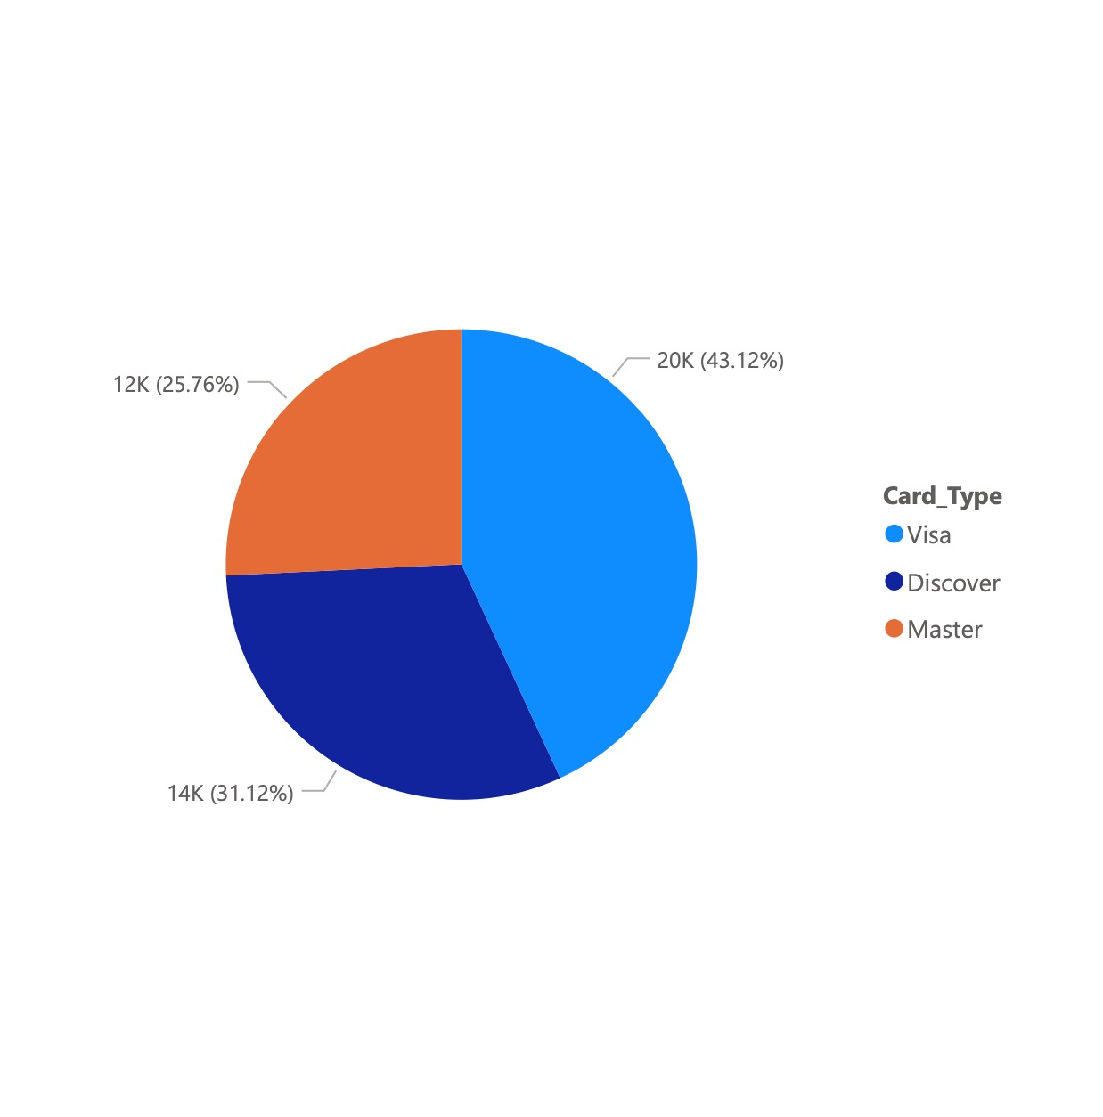

Slide 22
Thank you

